Slide 1
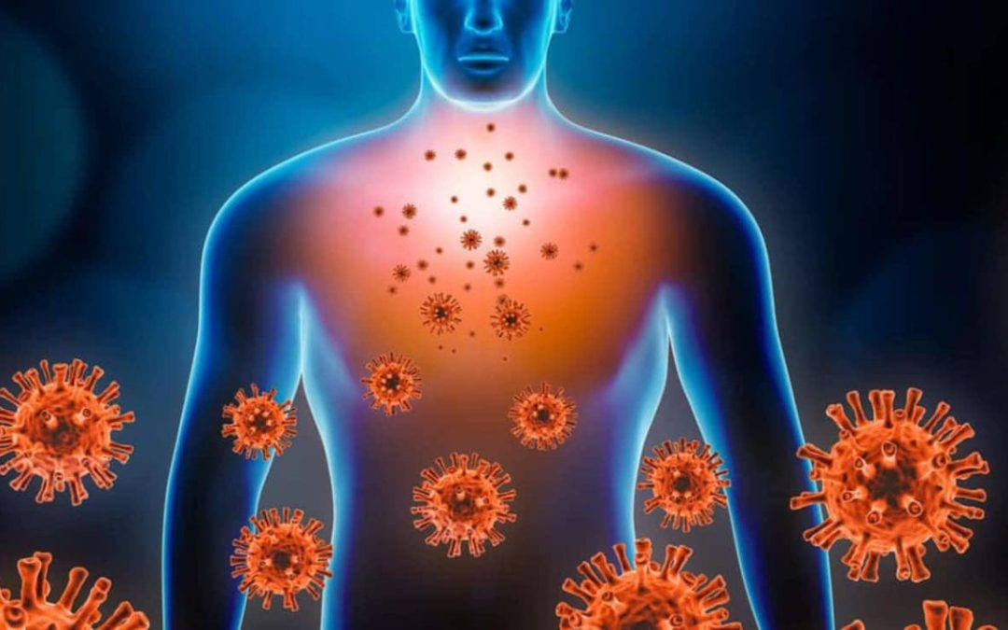
PHR 1103(09165105)
Advanced Pharmacology and Clinical Toxicology
Immunopharmacology
Zubair Khalid Labu
Professor
Pharmacy, WUB

Slide 2
Immunopharmacology
Immunopharmacology
Definition:
Immunopharmacology is the study of drugs that modulate the immune system, either enhancing or suppressing immune responses.
Examples:
Immunosuppressants: Corticosteroids, calcineurin inhibitors (cyclosporine, tacrolimus), monoclonal antibodies.
Immunostimulants: Cytokines (IL-2, interferons), vaccines, colony-stimulating factors.

Slide 3
HIV (human immunodeficiency virus) is a virus that attacks the body's immune system. If HIV is not treated, it can lead to AIDS (acquired immunodeficiency syndrome).
There is currently no effective cure. Once people get HIV, they have it for life.
But with proper medical care, HIV can be controlled. People with HIV who get effective HIV treatment can live long, healthy lives and protect their partners.

Slide 4
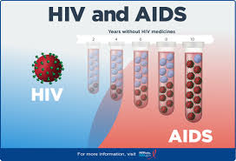
AIDS
AIDS stands for acquired immunodeficiency syndrome. AIDS is the most advanced stage of HIV infection. HIV attacks and destroys the infection-fighting CD4 cells (CD4 T lymphocyte) of the immune system. The loss of CD4 cells makes it difficult for the body to fight off infections, illnesses, and certain cancers.
Acquired immunodeficiency syndrome

Slide 5
Types of HIV medicines
There are many different types (called classes) of HIV medicines.
Some work by blocking or changing enzymes that HIV needs to make copies of itself. This prevents HIV from copying itself, which reduces the amount of HIV in the body. Several types of medicines do this:
Nucleoside(a compound (such as guanosine or adenosine) that consists of a purine or pyrimidine base combined with deoxyribose or ribose and is found especially in DNA or RNA) reverse transcriptase inhibitors (NRTIs) block an enzyme called reverse transcriptase
Non-nucleoside reverse transcriptase(an enzyme that catalyses the formation of RNA from a DNA template during transcription) inhibitors (NNRTIs) bind to and later change reverse transcriptase
Integrase(An enzyme found in HIV and other retroviruses). inhibitors, also called integrase strand transfer inhibitors (INSTIs), block an enzyme called integrase
Protease inhibitors (PIs) block an enzyme called protease
Some types of HIV medicines interfere with HIV's ability to infect CD4 immune system cells
Fusion inhibitors block HIV from entering the cells
CCR5(A protein on the surface of certain immune system cells, including CD4 T lymphocytes CD4 cells) antagonists and post-attachment inhibitors block different molecules on the CD4 cells. To infect a cell, HIV has to bind to two types of molecules on the cell's surface. Blocking either of these molecules prevents HIV from entering the cells.
Attachment inhibitors bind to a specific protein on the outer surface of HIV. This prevents HIV from entering the cell

Slide 6
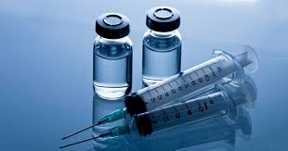
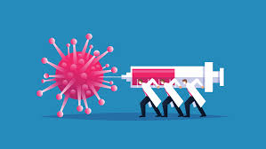
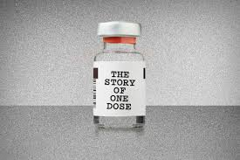
A vaccine is a biological preparation that provides active acquired immunity to a particular infectious or malignant disease. The safety and effectiveness of vaccines has been widely studied and verified. A vaccine typically contains an agent that resembles a disease-causing microorganism and is often made from weakened or killed forms of the microbe, its toxins, or one of its surface proteins. The agent stimulates the body's immune system to recognize the agent as a threat, destroy it, and recognize further and destroy any of the microorganisms associated with that agent that it may encounter in the future.

Slide 7
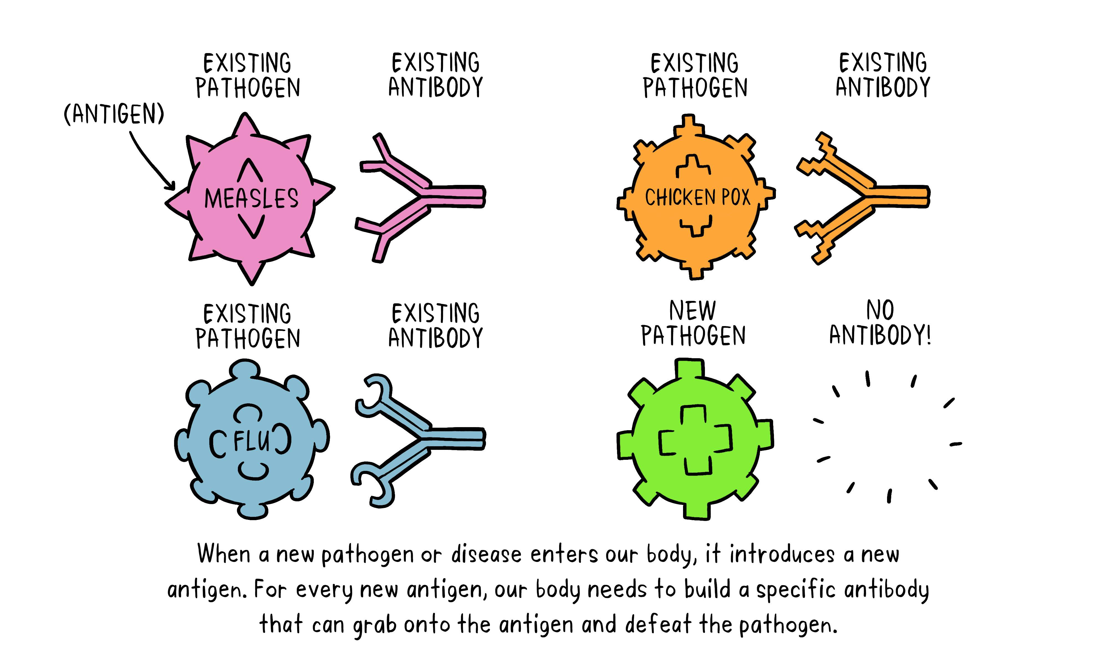
Vaccines and sera

Slide 8
Vaccine Types
There are several different types of vaccines.
Inactivated vaccines
Live-attenuated (a very effective type of vaccine used in the prevention of diseases including influenza, chickenpox, measles) vaccines
Messenger RNA (mRNA) vaccines
Subunit, recombinant, polysaccharide, and conjugate vaccines
Toxoid vaccines
Viral vector vaccines
Inactivated vaccines
Inactivated vaccines use the killed version of the germ that causes a disease.
Inactivated vaccines usually don’t provide immunity (protection) that’s as strong as live vaccines. So you may need several doses over time (booster shots) in order to get ongoing immunity against diseases.
Inactivated vaccines are used to protect against:
Hepatitis A
Flu (shot only)
Polio (shot only)
Rabies

Slide 9
Live vaccines are used to protect against: live vaccines also have some limitations. For example:
Because they contain a small amount of the weakened live virus, some people should talk to their health care provider before receiving them, such as people with weakened immune systems, long-term health problems, or people who’ve had an organ transplant.
They need to be kept cool, so they don’t travel well. That means they can’t be used in countries with limited access to refrigerators
-Measles, mumps, rubella (MMR combined vaccine)
-Rotavirus
-Smallpox
-Chickenpox
-Yellow fever
*mRNA vaccines are used to protect against:
COVID-19
Subunit, recombinant, polysaccharide, and conjugate vaccines
Hib (Haemophilus influenzae type b) disease, Hepatitis B,HPV (Human papillomavirus),
Whooping cough (part of the DTaP combined vaccine), Pneumococcal disease,Meningococcal disease
-Shingles(Shingles is a common condition that causes a painful rash. It can sometimes lead to serious problems such as long-lasting pain, hearing loss or blindness).
Toxoid vaccines are used to protect against:
-Diphtheria
-Tetanus

Slide 10
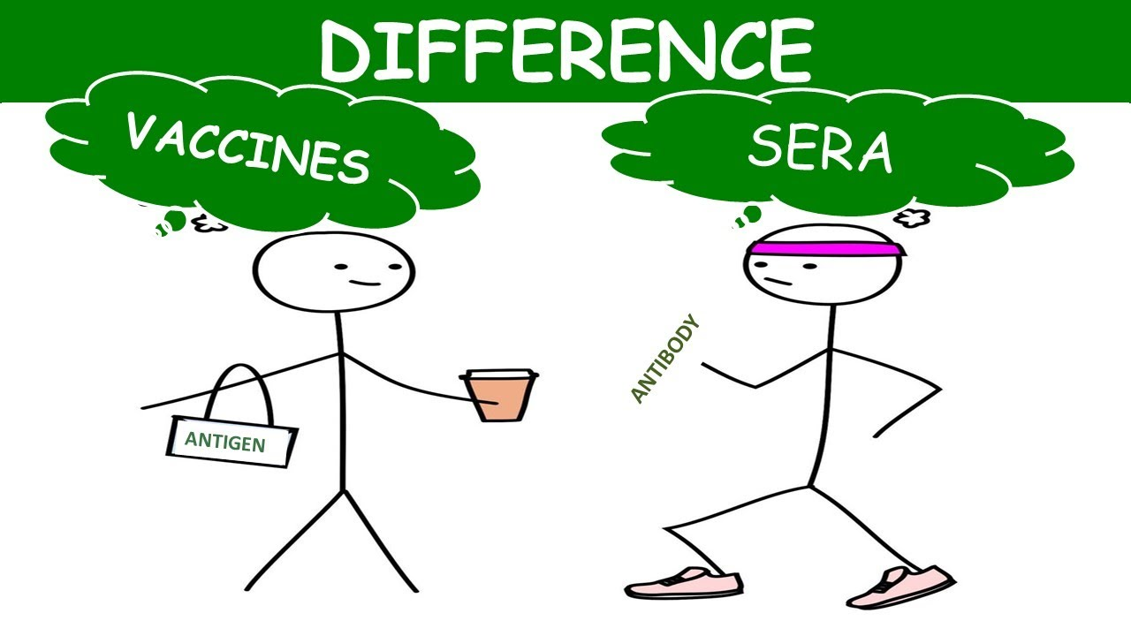
Sera in pharmacology
Serum that contains antibodies. The blood serum of an animal used to provide immunity to a pathogen or toxin by inoculation. It is obtained from an animal that has been immunized either by ANTIGEN(a toxin or other foreign substance which induces an immune response in the body, especially the production of antibodies.) injection or infection with microorganisms containing the antigen.

Slide 11
Immune-stimulant
Immunostimulants, also known as immunostimulators, are substances (drugs and nutrients) that stimulate the immune system usually in a non-specific manner by inducing activation or increasing activity of any of its components.
Types of Immunostimulants
bacterial vaccines.
colony stimulating factors.
interferons.
interleukins.
other immunostimulants.
therapeutic vaccines.
vaccine combinations.
viral vaccines.

Slide 12
Immunological tests
Immunological tests are widely used. Their areas of application include:
Allergy tests: These tests are used to detect antibodies against allergy-triggering substances like grass pollen or certain foods.
Determining your blood group: When blood transfusions are done, the person donating the blood and the person receiving the blood have to have the same blood group. Immunological tests can be used to determine the blood groups before a blood transfusion.
Bowel cancer screening: This test looks for the blood pigment hemoglobin, which is a sign of blood in stool. Blood in stool can be caused by various things, such as an inflammation of the lining of the stomach (gastritis), hemorrhoids, polyps or bowel cancer.
Diagnosing heart attacks and thrombosis: Shortly after a heart attack or if someone has thrombosis, higher levels of a certain protein are found in the blood. These can be detected using an immunological test.
Rapid tests for drugs and medication: Immunological tests can also be used to look for recreational drugs such as cannabis, ecstasy and cocaine. Medical drugs that affect the central nervous system can be detected in this way too. These include sleeping pills (benzodiazepines), amphetamines and morphine.

Slide 13
Immunological tests
Detecting germs that are causing an infection:
If it is thought someone has bacterial tonsillitis or scarlet fever, the test looks for Streptococcus bacteria. In the case of Lyme disease following a tick bite, there are tests that can detect the Borrelia bacteria that cause it, and there are tests that can detect the antibodies to Borrelia bacteria. Immunological tests can also be used to detect viruses. Examples include SARS-CoV-2 (COVID), hepatitis C, HIV and HPV viruses. Pregnant women can have a blood test to find out whether they are protected from (immune to) toxoplasmosis.
Pregnancy test:
Women can use this rapid test to find out whether their urine contains the "pregnancy hormone" beta-hCG.
Urine test:
If sugar, blood, proteins or inflammatory cells are found in urine using this rapid test, it could be a sign of diabetes, a urinary tract infection or kidney damage.
Immunological tests can also be used to diagnose congenital or acquired diseases of the immune system, differentiate between different forms of rheumatoid arthritis, or monitor the progression of an existing medical condition, such as certain types of cancer (in prostate cancer the PSA levels in blood are monitored).

Slide 14
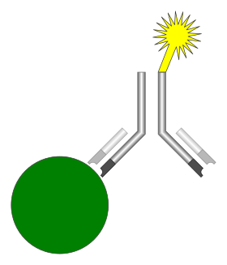
Immunoassay (IA) is a biochemical test that measures the presence or concentration of a macromolecule or a small molecule in a solution through the use of an antibody (usually) or an antigen (sometimes). test results can provide information about a disease that may help in planning treatment (for example, when estrogen receptors are measured in breast cancer).
Illustration of the basic components of an immunoassay, which includes an analyte (green), an antibody (black), and a detectable label (yellow)

Slide 15
Types of Immunoassays:
1. Enzyme-based immunoassays
ELISA (Enzyme-Linked Immunosorbent Assay) → enzyme produces color change.
EIA (Enzyme Immunoassay) → similar principle, detects hormones, drugs, pathogens.
2. Radioactive immunoassays
RIA (Radioimmunoassay) → uses radioactively labeled antigen/antibody.
Highly sensitive but less used now due to radiation hazards.
3. Fluorescent immunoassays
FIA (Fluorescent Immunoassay) → fluorochrome-labeled antibody.
Example: Flow cytometry, immunofluorescence microscopy.
4. Chemiluminescent immunoassays
Detection by light emission from chemical reaction.
Used in automated analyzers (hormone, infection screening).

Slide 16
5. Rapid immunoassays
Lateral Flow Assays → easy, quick tests.
Example: COVID-19 antigen test, home pregnancy test.
6. Other specialized types
Western Blot → detects specific proteins.
Immunodiffusion & Immunoelectrophoresis → for antigen-antibody precipitation in gels.
Agglutination tests → clumping of antigen-coated particles (blood grouping test).

Slide 17
THANK YOU

